Slide 1
Distributed Algorithms 2018/19 Distributed Applications & Hot Topics
Danh Le-Phuoc | Open Distributed Systems
With material from O. Kao @ CIT

Slide 2
Overview
Grid & Cloud Computing
Ubiquitous Computing
Internet of Things
Big Data
Integrating Big Data, Cloud, IoT

Slide 3
Grid & Cloud Computing

Slide 4
Cloud Computing & Virtualization
In order to understand the motivation behind Cloud Computing, we must take a look back into the past …
The Grid, the predecessor of the Cloud
If at all, where actually is the difference between Grid and Cloud Computing?

Slide 5
Grid Computing
Grid Computing is the virtualization of all resources …
Task
Before the Grid: A user is aware of the resources he utilizes
Resources are usually owned by the user
User is aware of location
User is aware of capacity limits
User submits task to a distinct set of resources (e.g. a mainframe or a powerful workstation)
User is aware of platform and execution environment offered by his resources
Result

Slide 6
Grid Computing
Grid Computing is the virtualization of all resources …
Users and institutions connect their local resources to constitute a large overall one.
A Middleware that hides the distribution and heterogeneity of the new „super“ - resource is required.
The Grid

Slide 7
Grid Computing
Grid Computing is the virtualization of all resources …
Task
Grid Middleware
The Grid
Task

Slide 8
Grid Computing
Grid Computing is the virtualization of all resources …
Result
Grid Middleware
Result
The Grid

Slide 9
Grid Computing
Grid Computing is the virtualization of all resources …
Result
Grid Middleware
Result
The Grid
With the Grid: User utilizes one large virtual resource
User is unaware of location, capacity limits
User adapts tasks towards spec of middleware
Users share their local resources

Slide 10
Grid Computing - Motivation
Origin of the idea
Shared: supply per demand, payment per use

Slide 11
Grid Computing - Motivation
Origin of the idea:
Shared: supply per demand, payment per use
Water Supply
Accounting

Slide 12
Grid Computing - Motivation
Origin of the idea:
Shared: supply per demand, payment per use
Water Supply, Power Supply
Accounting

Slide 13
Grid Computing - Motivation
Origin of the idea:
Shared: supply per demand, payment per use
Water Supply, Power Supply, Internet
Accounting

Slide 14
Grid Computing - Motivation
Origin of the idea:
Shared: supply per demand, payment per use
Water Supply, Power Supply, Internet – computing time?
The Grid
Accounting

Slide 15
Grid Computing - Definition
Flexible, secure, coordinated use of resources among a dynamic group of individuals, institutions and resources
(The Anatomy of the Grid: Enabling Scalable Virtual Organizations)
Enabling of communities („virtual organizations“) to share spatially distributed resources in order to reach a mutual aim with the following assumptions:
no central surveillance/control
no information on shared/participating resources
without the pressure of preceding, static agreements, …

Slide 16
Grid Computing - Approach
Demand
Job
User
Interface

Slide 17
Grid Computing - Approach
Information
Service
Demand
Job
User
Interface

Slide 18
Grid Computing - Approach
Information
Service
Job
User
Interface
Resource Scheduling

Slide 19
Grid Computing - Approach
Information
Service
User
Interface
Resource Scheduling
Resource Allocation
Job

Slide 20
Grid Computing - Approach
Information
Service
User
Interface
Resource Scheduling
Data
Management
Resource Allocation
Job

Slide 21
Grid Computing - Approach
Information
Service
Job
Execution
User
Interface
Resource Scheduling
Job
Data
Management
Resource Allocation

Slide 22
Grid Computing - Approach
Monitoring
Information
Service
Job
Execution
User
Interface
Resource Scheduling
Job
Data
Management
Resource Allocation

Slide 23
Grid Computing - Approach
Monitoring
Information
Service
Job
Execution
User
Interface
Resource Scheduling
Results
Data
Management
Resource Allocation

Slide 24
Cloud Computing
Shifting services / load into the network …
Shift complexity from end-device into network
Weight and battery life become more important than computing power
„Laziness“ – Accessing services from the network reduces efforts for administering own devices
Instead of buying resources, rent them on demand!
Important paradigm: Pay-as-you-Go (PAYG)
The Cloud
Instead of using local …
(USB/Internal) Hard Disk Drive
Calender, Contacts Application
Use …
Online-Storage Service (e.g. Drop Box)
Social-Network
Office Application
Cloud-Service (e.g. Google Docs)

Slide 25

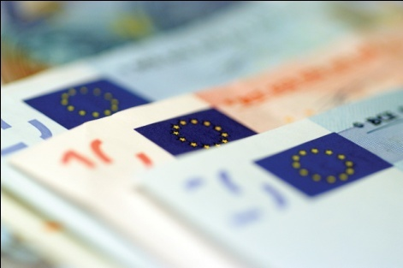
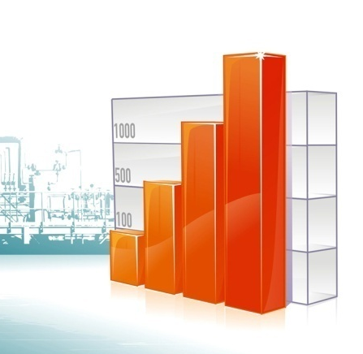
Cloud Computing – Paradigm Change
Focus on business idea and implementation, not on technical infrastructure
No equipment acquisition, but on-demand renting from the Cloud
Pay the resources from current income of the business – „Pay as you earn“
Improve utilization of resources and scalability of application
Rent according to current demands
Extend dynamically -> Elasticity

Slide 26
Cloud Computing – Paradigm Change
Why is Elasticity so important?
Example: Web Server utilization problem
Load
Available
capacity
Actual load
Time

Slide 27
Cloud Computing - Definition
Definition (approach) by NIST (National Institute for Standards and Technology):
“Cloud computing is a model for enabling ubiquitous, convenient, on-demand network access to a shared pool of configurable computing resources (e.g., networks, servers, storage, applications, and services) that can be rapidly provisioned and released with minimal management effort or service provider interaction.”
Crucial elements of this definition:
Convenient = simple and easy to use interfaces
On-demand = rapid provision
Shared Pool = no dedicated resources, multi-tenant
Minimal Management Effort = access pool using standardized interfaces and services offered by the provider

Slide 28
Cloud Computing – Definition
NIST Definition (Continued)
Cloud Model is composed of 5 essential characteristics, three service models and five deployment models
5 Characteristics:
On-demand self-service: allocate and access computing resources (e.g. server time or network storage) as required without the need for human interaction with each service provider
Broad network access: Computing resources are made available over a network and standard mechanisms allow accessing these resources using heterogeneous client devices
Resource pooling: Providers pool and dynamically provision computing resources to multiple consumers -> better utilization.
A key driver for resource pooling: virtualization.
Rapid elasticity: illusion of an endless resource, that can be accessed from anywhere at any time. Resources can be elastically provisioned and released on-demand
Measured service: resource consumption can be monitored in order to provide transparency for Cloud service providers and consumers

Slide 29
Cloud Computing – Definition
NIST Definition (Continued)
3 Service Models:
Software as a Service - SaaS
(Business) Applications are provided as standardized services
Examples: Mail-App, Google-Docs, …
Platform as a Service - PaaS
Tools and APIs that take care of IaaS layer and simplify development are provided
Examples: APIs for billing, IAM, load balancing, … -> Google App Engine, Amazon AWS
Infrastructure as a Service - IaaS
Computing, network and storage infrastructure is provided
Examples: rent and connect virtual machines on Amazon EC2 or Rackspace Cloud

Slide 30
Cloud Computing – Definition
NIST Definition (Continued)
4 Deployment Models:
Private Cloud: use by a single organization (e.g. tubCloud)
Community Cloud: open for a specific community (e.g. companies involved in a big project)
Public Cloud: open for general public (e.g. Amazon EC2, Rackspace)
Hybrid Cloud: composition of the other approaches

Slide 31
Cloud Computing
Can you remember the initial question?
If at all, where actually is the difference between Grid and Cloud Computing?
Can you answer it?

Slide 32
Cloud Computing
Grid and Cloud Computing share important characteristics:
Resource sharing
Improve utilization of resources
Abstract computation/processing of tasks -> provide a simple interface to access large scale computational resources
Grid and Cloud Computing are not mutually exclusive:
A Grid service may exist within a Cloud and a part of Grid may be used as a Cloud

Slide 33
Cloud Computing
However, the Cloud Model incorporates more than the Grid:
Service Models that go beyond IaaS -> PaaS, SaaS
Elasticity
Grid is focused on one large Job that is divided into parts and executed on multiple machines -> usually requires knowledge of execution environment and parallelization of code

Slide 34
Ubiquitous Computing

Slide 35
Mobile & Ubiquitous Computing
Mobile Computing is the execution of computing tasks while user is on the move
Users away from „Home Intranet“ are still able to access their resources via devices they carry
Utilize resources nearby (e.g. printers, sales points, Wifi) -> also known under the terms location-aware and context-aware computing
Internet
Host Site
Host Intranet
Company Site
Home Intranet
W-LAN
Printer
GPS satellite signal
3G/5G phone network
File-Server
Application-Server

Slide 36
Mobile & Ubiquitous Computing
Challenges:
Variable connectivity and indeed disconnection
Maintain operation in the face of device mobility (see transparency challenge known from Distributed Systems)
Physical integration and spontaneous interoperability
Standard user environment on all devices
Adjusted security concepts (Usability vs. Security and Privacy)
Extension of bandwidths

Slide 37
Mobile & Ubiquitous Computing
Ubiquitous Computing = Trend of “informatization” and networking of all things
Past: One single monolithic computing systems to serve all our digital needs
Today: Nearly all computer are connected via the Internet
(Near) Future: everyday objects are enriched by built-in sensors and processors and become able to communicate with each other
Instead of using one single monolithic computing system, our everyday needs are fulfilled by all the small devices and things surrounding us

Slide 38
Mobile & Ubiquitous Computing
Ubiquitous Computing example: Smart Labels/RFIDs
Small (some mm²) transponders use high frequency radio waves both for communication and as energy source
Utilization:
Substitute for barcodes, but no reading device necessary
Increased capabilities of RFID -> Substitute of theft protection system:
Instead of only one code for paid/stolen, e.g. product statistics can be generated

Slide 39
Mobile vs. Ubiquitous Computing
Mobile and Ubiquitous Computing overlap, but:
Mobile Computing focuses the mobility of the user
Mobile Computing works with regular computing devices (e.g. Laptops)
Ubiquitous Computing focuses the ubiquity of the devices
Ubiquitous Computing works at a single location (e.g. Smart Home)

Slide 40
Mobile vs. Ubiquitous Computing
The Ubiquitous Computing vision is based on the proliferation of the so-called “enriched everyday objects” (i.e. connected and embedded devices)
These devices nowadays have become the rule rather than the exception
Several research domains related to Distributed Systems and Algorithms deal with networks of such devices:
(Wireless) Sensor Networks, Body Area Networks, Wearables
Mobile Ad-Hoc Networks
Machine to Machine Communication
Opportunistic Networks and Computing
Mobile Cloud/Grid Computing
The recent Internet of Things (IoT) paradigm is an intersection of all these domains

Slide 41
Internet of Things (IoT)

Slide 42
Internet of Things (IoT)
One concept, many application domains ..
INDUSTRY
CITIES
Internet of Things
TRANSPORT
HEALTH
HOME

Slide 43
Internet of Things - Definition
Definition (approach) by CERP-IoT (Cluster of European Research Projects on the Internet of Things):
“ Internet of Things (IoT) is an integrated part of Future Internet and could be defined as a dynamic global network infrastructure with self configuring capabilities based on standard and interoperable communication protocols where physical and virtual “things” have identities, physical attributes, and virtual personalities and use intelligent interfaces, and are seamlessly integrated into the information network. In the IoT, “things” are expected to become active participants in business, information and social processes where they are enabled to interact and communicate among themselves and with the environment by exchanging data and information “sensed” about the environment, while reacting autonomously to the “real/physical world” events and influencing it by running processes that trigger actions and create services with or without direct human intervention. Interfaces in the form of services facilitate interactions with these “smart things” over the Internet, query and change their state and any information associated with them, taking into account security and privacy issues.”
Notes:
This is to make clear that there is no straightforward definition and its still in progress!

Slide 44
Internet of Things - Definition
Conceptual approach …
What are physical things? -> Any kind of items or areas that are part of our environment:
Packets used to deliver other items like tools, components (e.g. in factories), or food
Refrigerators used to refrigerate food
Cars or any other kind of vehicle used to transport packets
Parking areas used to park vehicles
…
And of course, all your existing devices like smart phones, tablets, laptops, pc’s are things as well

Slide 45
Internet of Things - Definition
What makes a physical thing become a virtual thing? -> A virtual representation that allows other nodes or processes in our distributed system to access the thing is required:
Packets may be tagged with RFID
Kitchenware and cars may be shipped with embedded systems
Parking areas may be monitored by sensors
Information Network
VR
VR
VR

Slide 46
Internet of Things - Definition
What is a virtual thing a.k.a. a virtual representation?
A technical extension to the physical things that provides communication capabilities (e.g. an embedded system)
A unique ID / address that allows us to connect to the thing based on its communication capabilities
A (standardized) communication protocol and an interface that describe how to connect to the thing
> all together: integration of the thing into an information network and embedding it into processes/workflows
Information Network
VR
VR
VR

Slide 47
Internet of Things – M2M
Machine to Machine communication (M2M) is one of the building blocks ..
Definition by M2M Alliance (loosely translated):
“M2M is the ability of two technical systems like machinery, vehicles or containers to exchange data with each other or with a central instance in an automated manner.”

Slide 48
Internet of Things – M2M
An M2M architecture consists of a:
Data Endpoint (DEP): technical extension to the physical things that provides communication capabilities and collects data from it
Machinery
DEP

Slide 49
Internet of Things – M2M
An M2M architecture consists of a:
Data End Point (DEP): technical extension to the physical things that provides communication capabilities and collects data from it
Data Integration Point (DIP): collects data from the DEPs or sends control commands to them
Machinery
DEP
DIP

Slide 50
Internet of Things – M2M
An M2M architecture consists of a:
Data End Point (DEP): technical extension to the physical things that provides communication capabilities and collects data from it
Data Integration Point (DIP): collects data from the DEPs or sends control commands to them
Machine Communication Network (MCN): DEP and DIP exchange data via the MCN
Machinery
DEP
Machine Communication Network
DIP

Slide 51
Internet of Things – M2M
Where is the difference between M2M and IoT?
M2M using IP-based protocols can be considered as a subset of the IoT enabling remote access to the things
M2M can be realized within a single factory, whereas a similar IoT setup would be rather called Intranet of Things
IoT in general is more focused on a technology-agnostic integration of all things and the delivery of accompanying services like security, privacy, data analytics, accounting

Slide 52
Internet of Things – M2M
By the way, where is the difference between Ubiquitous Computing (UC) and IoT?
Both concepts overlap and are sometimes used interchangeably
UC is more than a technical concept (a vision) and additionally deals with user interaction in environments of smart objects
UC is about making objects intelligent / smart and creating concepts for user interaction
IoT is much more focused on technical issues, especially creating virtual representations of physical objects integrated into information networks

Slide 53
Internet of Things – M2M
By the way, where is the difference between Ubiquitous Computing (UC) and IoT?
Both concepts overlap and are sometimes used interchangeably
UC is more than a technical concept (a vision) and additionally deals with user interaction in environments of smart objects
UC is about making objects intelligent / smart and creating concepts for user interaction
IoT is much more focused on technical issues, especially creating virtual representations of physical objects integrated into information networks
In general: many terms and overlapping concepts exist (e.g. Internet of Everything, Web of Things, Cyber Physical Systems, Industrial Internet). What is important, are the fundamental Distributed Systems concepts (the glue) behind the scenes!

Slide 54
Internet of Things
What are the main challenges for realizing the IoT?
Heterogeneity - a variety of different sensors, devices, protocols, …
Openness - new sensors, devices and protocols are released day by day
Security - is the sensor authentic?
Scalability - how to implement systems that can handle billions of connected sensors?
Quality of Service - can entertainment and e-heath system share the same network in your smart home?
…
Data Analytics
Device Integration
Privacy
Mobility
Abstraction
…

Slide 55
Internet of Things
What are the main challenges for realizing the IoT?
Heterogeneity
Openness
Security
Scalability
Quality of Service
…
Data Analytics
Device Integration
Privacy
Mobility
Abstraction
…
Do you remember these challenges?
The Internet of Things is one of the most recent research domains dealing with the application of fundamental Distributed Systems principles to current use cases.

Slide 56
Internet of Things
In general, one of the most recent challenges is how to gain benefit from all the data collected by the IoT?
-> Big Data!?

Slide 57
Big Data
Notes:
Big Data is no HPC!

Slide 58
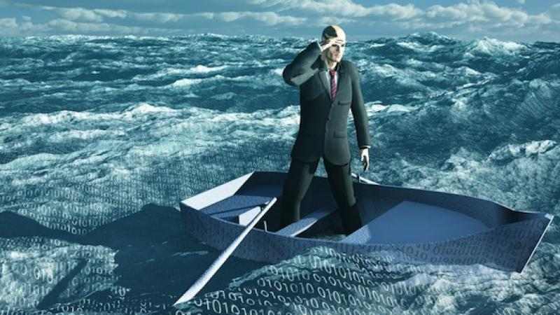

Big Data
Two motivations for Big Data:
If the IoT becomes reality, Billions of devices will be connected to the Internet and generate data
In order to gain benefit from the IoT, the data must be processed and analyzed
Every day, about 2.500.000 TB of data are created
Social networks, tweets, blogs, messengers, magazines and journals, behavioral analysis meta data
Which kinds of infrastructures / systems / algorithms
are suitable to process these amounts of data?
Notes:
Big Data is no HPC!

Slide 59
Big Data - Definition
Definition by Gartner:
“Big data is high-volume, high-velocity and/or high-variety information assets that demand cost-effective, innovative forms of information processing that enable enhanced insight, decision making, and process automation.”
The 3 V’s (or dimensions) of Big Data:
Volume: the volume / the amount of data
Exponential growth in data and data storage capabilities
Reinforcement by Big Data itself, analysis of data creates more data
Are the applications and architectures suitable to handle Terabytes or Petabytes of data?

Slide 60
Big Data - Definition
Definition by Gartner:
“Big data is high-volume, high-velocity and/or high-variety information assets that demand cost-effective, innovative forms of information processing that enable enhanced insight, decision making, and process automation.”
The 3 V’s (or dimensions) of Big Data:
Velocity: the increasing speed in which data is generated or updated
Social networks, news channels and tweets have outperformed the classic new paper model -> data generated yesterday is not recent any more
The velocity in which we react to events and create new data has rapidly increased

Slide 61
Big Data - Definition
Definition by Gartner:
“Big data is high-volume, high-velocity and/or high-variety information assets that demand cost-effective, innovative forms of information processing that enable enhanced insight, decision making, and process automation.”
The 3 V’s (or dimensions) of Big Data:
Variety: diversity of data sources and data formats
Meaningful analysis and decision making often requires to consider a variety of sources
Sources provide data in different formats: simple text, databases, excel, video, pictures, SMS, tweets, pdf, …

Slide 62
Big Data - Definition
Definition by Gartner:
“Big data is high-volume, high-velocity and/or high-variety information assets that demand cost-effective, innovative forms of information processing that enable enhanced insight, decision making, and process automation.”
The 3 V’s (or dimensions) of Big Data:
(Value): ability to turn data into value / benefit
Just collecting huge amounts of data does not imply that one is able to gain benefit from analyzing it
(Validity / Veracity): huge amounts of data are less controllable in terms of quality and accuracy
Tweets use natural language which includes abbreviations, typos, colloquial speech, emoticons, …

Slide 63
Big Data - Example
(Possible) architectures / frameworks for Big Data
Examples for Big Data frameworks Apache Flink, Apache Hadoop, Apache Spark, …
Engines to execute Big Data programs / jobs
A Big Data program / job is often represented as a Directed Acyclic Graph (DAG)
Example: conversion of an article DB, articles saved as bitmaps, desired output is PDF
Vertices of the DAG are tasks, edges are communication links
Step 1 - Input
Step 2 – Processing 1
Step 3 – Processing 2
Step 4 - Output
File-Reader Task
OCR
Task
PDF-Creator Task
PDF-Writer Task
Notes:
Say something on batch vs. Stream processing

Slide 64
Big Data - Example
A Big Data program / job is often represented as a Directed Acyclic Graph (DAG)
Example: conversion of an article DB, articles saved as bitmaps, desired output is PDF
Vertices of the DAG are tasks, edges are communication links
Big Data engines optimize DAGs and map them to available infrastructure (e.g. compute cluster)
Big Data Engine
Step 3 – Processing 2
PDF-Creator Task N
Step 2 – Processing 1
…
OCR
Task 2
Step 1 - Input
OCR
Task 1
Step 4 - Output
File-Reader Task
PDF-Creator Task 1
PDF-Writer Task

Slide 65
Evolution of Big Data Platforms
Flink
4G
In-memory + Out of Core Performance, Declarativity, Optimisation, Iterative Algorithms, Streaming/Lambda
Spark
In-memory Performance and
Improved Programming Model
3G
Hadoop
Scale-out, Map/Reduce, UDFs
Relational Databases
2G
1G

Slide 66

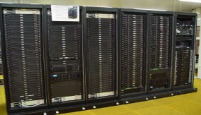
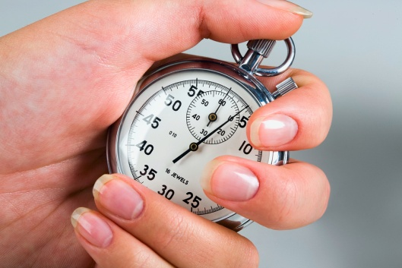
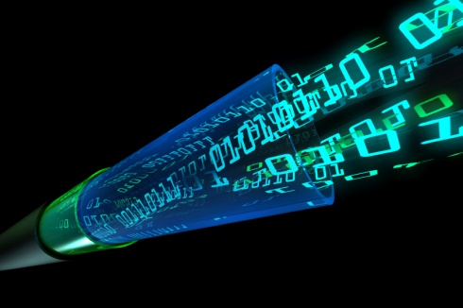
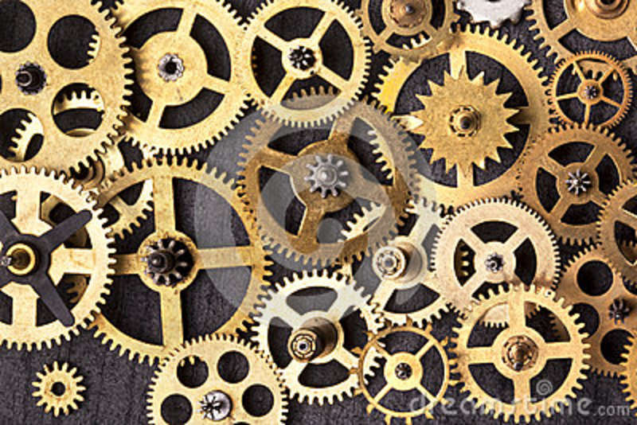
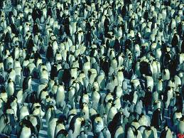
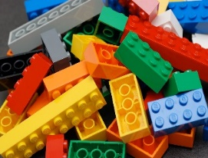
Technological Challenges for Deep Analysis on Big Data
Optimizing Access on Raw Data: in-situ data analysis
Adaptive Seamless Deployment: Scale from laptop to cluster
Evolving Datasets: First results fast, stream mining
Low Latency Streaming: Distributed, heterogeneous CPUs
Advanced Data Analysis Programs: Declarative specification and optimization of programs with iteration and state
Multi-tenancy: Continuous, workload-aware optimizations
Engines: one size does not fit all - pluggable engines and libraries

Slide 67
MapReduce Evolutions (1/3)
Improved programming model with rich operator and functionality set
Joins, groupBys, filters, iterations and windows besides map and reduce operators
This simplifies a wide array of computations, including:
Iterative machine learning,
Streaming and
Complex batch jobs
Iterate
Source
Map
Reduce
Join
Reduce
Sink
Source
Map

Slide 68


MapReduce Evolutions (2/3)
Keep intermediate results in memory
Instead of writing them to disk
Can speed up iterative programs by 100x
MapReduce/Hadoop
Map
Reduce
Map
Reduce
2nd Gen. Processing Framework
Map
Reduce
Map
Reduce

Slide 69
MapReduce Evolutions (3/3)
Generalize processing engine to handle streams
Use a batch engine but make batches really small
Also called Micro batches
Creates “illusion” of continuous stream
Use a real streaming engine
Continuous data flows rather than finite blocks
Batch becomes a special case of streaming
Stream processing requires redefinition of operators
E.g. classic reduce function does not make sense
Instead: window operators (e.g. on all keys of last 5 sec.)

Slide 70
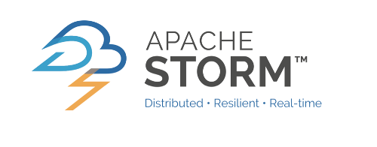




Successors of MapReduce
MapReduce/Hadoop spawned several 2nd generation data processing frameworks
Address the shortcomings of classic MapReduce
Some are specialized, some general purpose

Slide 71
Integrating Big Data, Cloud, IoT
The IoT provides the data
The Cloud provides the resources to process the data
Big Data provides the mechanisms required to gain benefit from the data
How to connect them?

Slide 72
Integrating Big Data, Cloud, IoT
Many solution for the integration of IoT and Cloud Computing concepts follow the Sensor-Virtualization approach
Cloud
Unified Sensor API
Sensor-Virtualization Service
Virtual Sensor
Virtual Sensor-Group
Big Data Engine
Users
Applications
Virtual
Space
Physical
Space
Gateway
Gateway
Sensors

Slide 73
Integrating Big Data, Cloud, IoT
A lot of currently developed and deployed solutions are Cloud-centric designs
Get the data from the sources
Transmit the data to the Cloud
Process the data
Send the results to the sinks
Recently, it has been recognized, that this model has some drawbacks regarding distribution of load, network congestion and latency (QoS)
A lot of research is currently being carried out to move load from to core to the edge of the network (i.e. utilize the mobile edge devices like routers, smart phones, … )
Broadening the scope of the Cloud to move processing closer to data sources
This includes topics such as Fog/Mist Computing, Mobile Edge Computing, Mobile Cloud Computing, …
-> more nodes, more (unreliable) communication links -> impact on our Distributed Systems -> impact on Distributed Algorithms

